Slide 1

Automatic water heater
19H51A04J7,d.narasimha
19H51A05K3,G.ganendhar
19H51A05L3,p.arpitha
19H51A04K6,k.sravani
19H51A05L5,p.shivasai
Team - 09

Slide 2
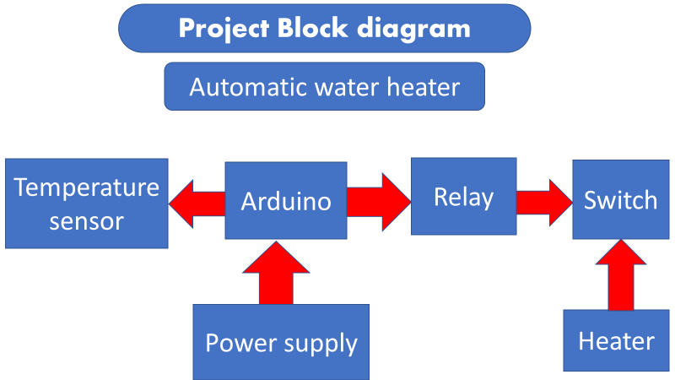

Slide 3
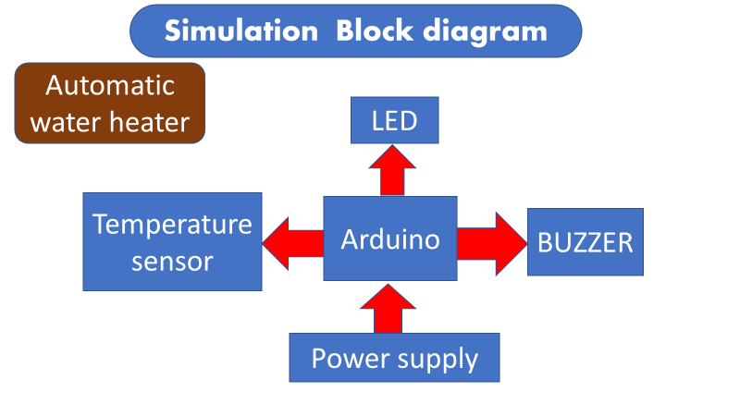

Slide 4
Problem statement
People often forget to switch off the power supply of electric water heater after the water is heated due to which electricity is wasted unnecessarily and power charges also increases implement an automatic water heater which turns off automatically when water is heated.
3rd version of problem statement
Design a water heater which turns off automatically when water is heated and a buzz sound and led should glow as an indication that water is heated and make it implementable for normal usage.

Slide 5
Objectives :
1)The model should automatically turn off the power supply to the water heater when water is heated
2)The buzzer must produce a sound when water is heated as an indication
3)The LED must glow as an indication
Constrains :
1)The model must be in budget
2)t should be safe to use
3)It should consume less space
4)It shouldn’t consume much power
5)Easy to use and install
Functions:
1)It automatically cuts the power supply when temperature limit is reached
2) When water is heated it produces alarming sound
3)The LED glows as an indication

Slide 6
User requirements
Heater must automatically cut the power supply when temperature limit is reached
It must be portable
It shouldn’t consume much space
It must be affordable
Safe to use
Easy to install and use
Shouldn’t consume much power
It must take various temperature inputs as limits
Must be durable for at least 12 months

Slide 7
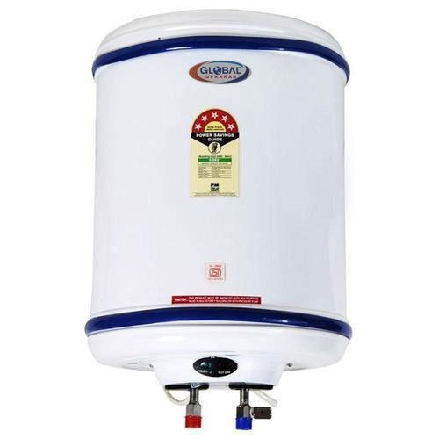
Existing systems
1.Electric Hot Water System: Electric storage systems use a heating element located inside a tank to heat water, similar to the way an electric kettle works. Water is heated and stored in the tank, available in various sizes, where it is kept hot and ready to be used
COST: 4000₹
SIZE : 75 ltr to 120 ltr
Power consumption:
3000 watts to 4000 watts

Slide 8
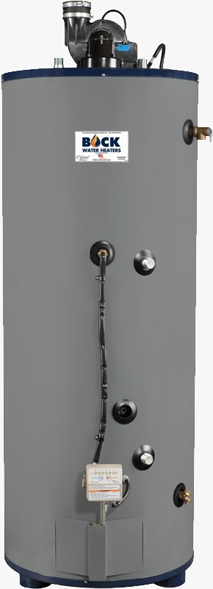
2. Gas Hot Water System: A gas hot water system is a water heating system where the main fuel used is gas. Hot water systems that use gas haven’t been as common in Australia traditionally as the humble electric tank, although that is starting to change as the gas grid has expanded and modern style electronic ignition continuous flow water heaters that have features like touch pad temperature control have now evolved .
Cost
Size
Power consumption
: 7000₹
: 190 ltr
: 4000 watts

Slide 9
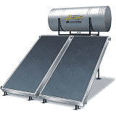
3. Solar water Heater: System With global warming becoming a real threat to the planet, eco-friendly solutions are being advocated to lower greenhouse gas emissions. Solar hot water system are one of the best examples of eco-friendly solutions in water heating. The system is powered by solar energy that is freely available and renewable.
Cost
Size
Draw backs :
: 21000₹
: 100 ltrs
Not easy to install and run

Slide 10
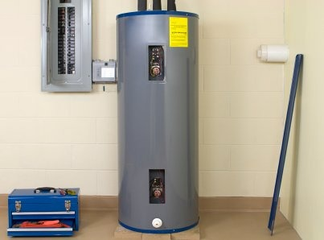
4. Heat Pump Water Heater: Heat pump water heaters use a small amount of electricity to move heat from one place to another, rather than generating heat directly. To heat water, a heat pump works like a refrigerator in reverse. There are different types of heat pump systems but the most common type are when the evaporator absorbs whatever heat energy is available from the air and vaporizes the refrigerant. This vapor is then compressed raising its pressure and temperature. Cold water from the storage tank is now pumped through the evaporator heat exchanger with the now heated water returning back to the storage cylinder.
Cost
Size
Power consumption
: 50000₹
:
901-1200 sf
: 3000 watts

Slide 11
Existing systems gaps in existing systems(drawbacks)
1) It may explode 2) And It stops heating the water after water is heated but the power continues to flow into the heater
Due to the pressure inside it may explode
It is expensive to install and use
1)These water heaters function only when cloudy rainy foggy days
2)These require large space and sufficient light
To fall on them to function
1)They can waste up to 15% of energy through radiant heat loss
2) Heat pumps may not be comfortable to use in cold environments, because they can cool the environment, which will not be good for basements that should be warm and dry

Slide 12
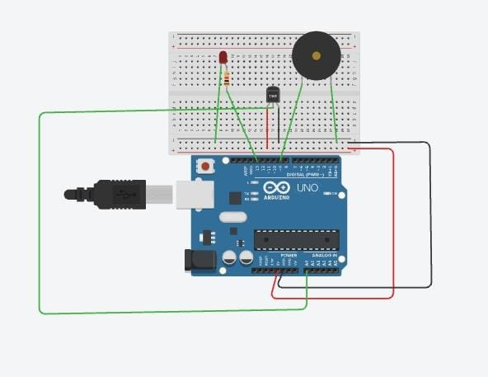
Hardware diagram

Slide 13
Hardware components
Software components
Arduino UNO
Breadboard
Temperature sensor
Led
Buzzer
Resistor
Jumper wires
Arduino Programmer(IDE)
Embedded C language

Slide 14
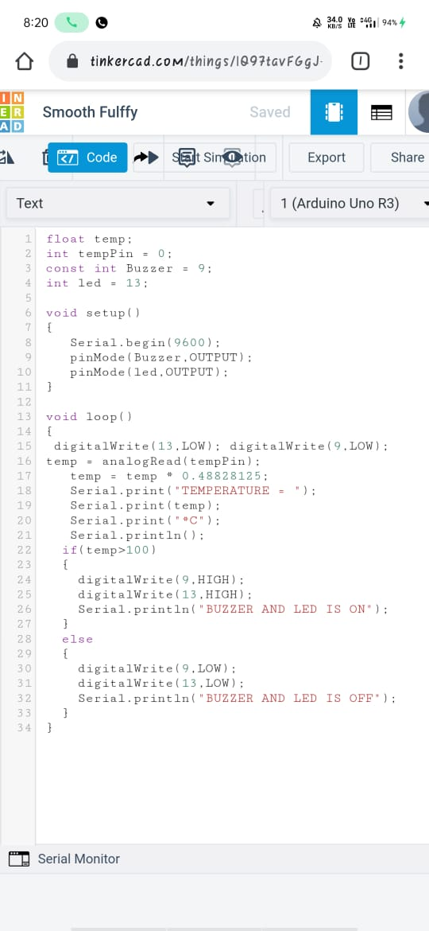
start
Functional Flow chart
Software
Compile and upload code to Arduino
Measure temperature
NO
Is the temperature above 100°c
YES
Buzzer makes a sound
Turn the led on
stop

Slide 15
Tinkercad simulation
https://www.tinkercad.com/things/8WZV1XvPLOY-eep-simulation-project/editel

Slide 16
Paper models

Slide 17
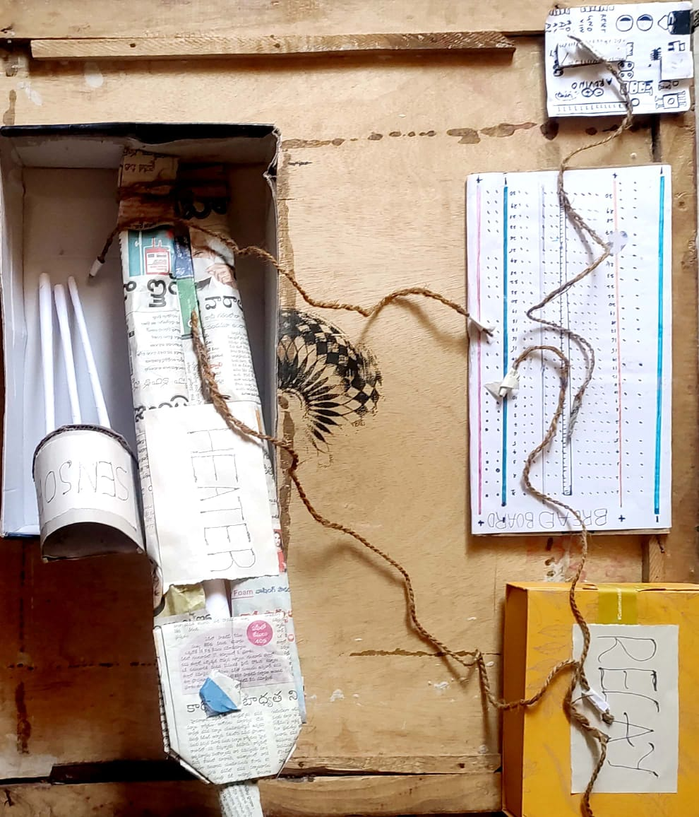
K.SRAVANI (19H51A04K6)

Slide 18
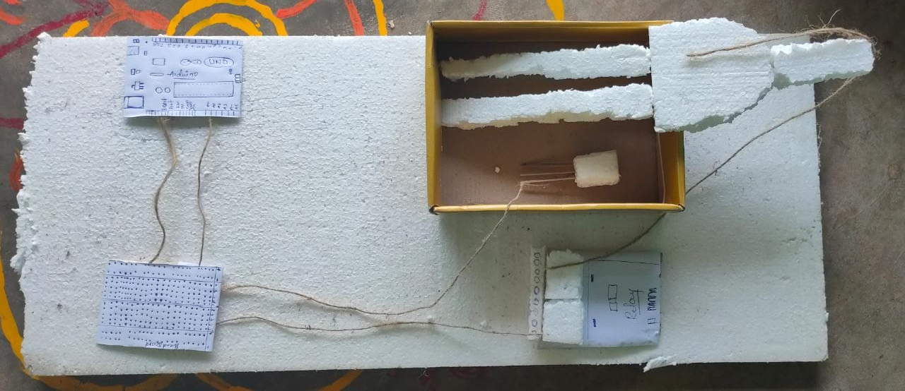
G.GANENDHAR (19H51A05K3)

Slide 19
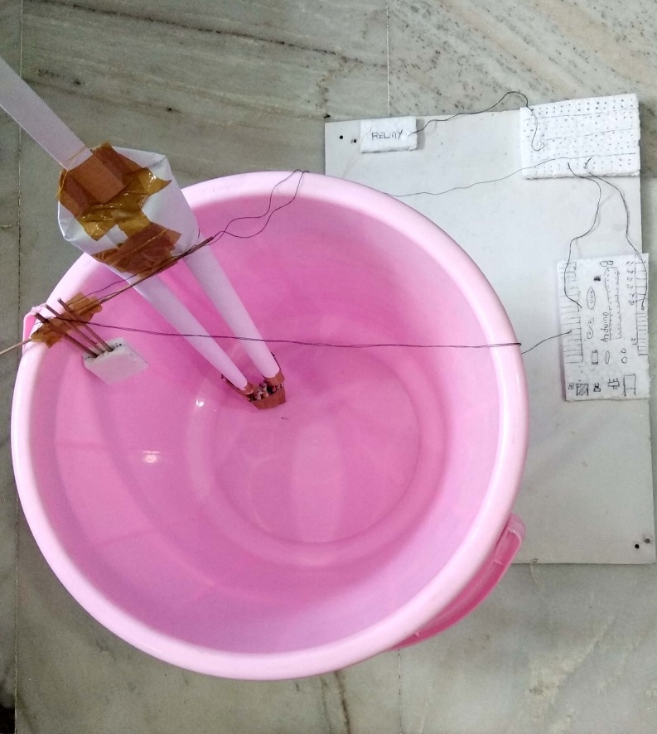
D.NARASIMHA (19H51A04J7)

Slide 20
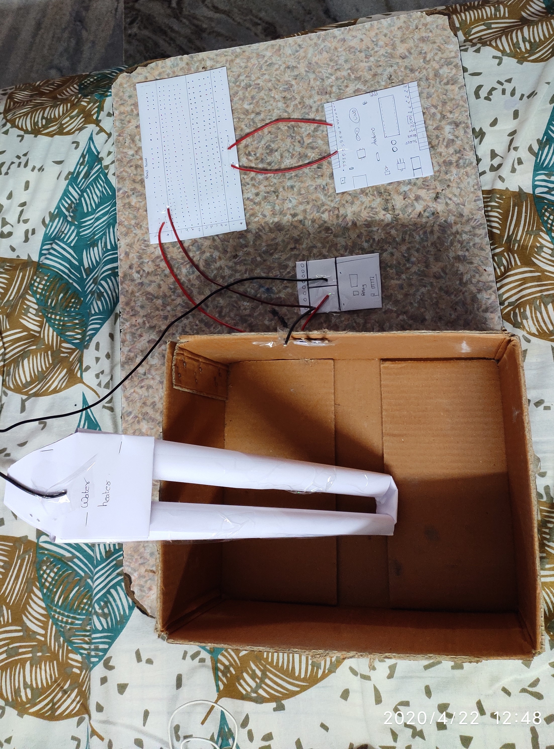
P.SHIVASAI (19H51A05L5)

Slide 21
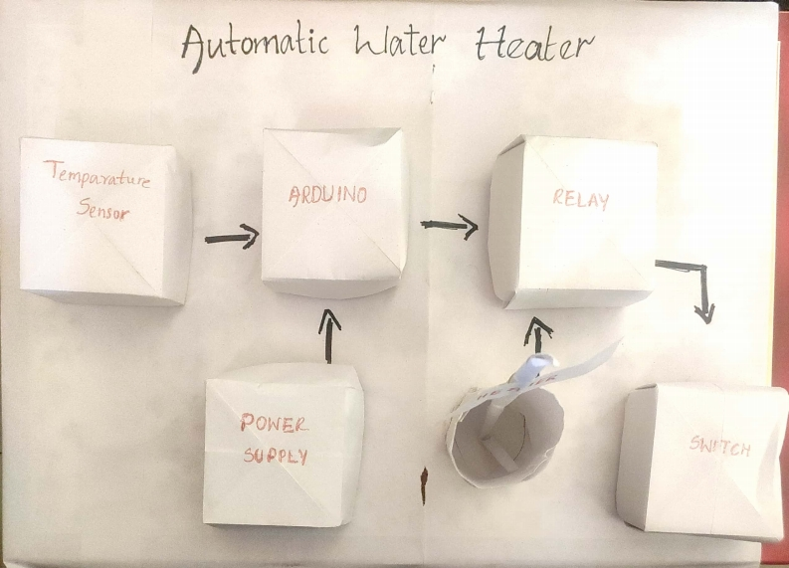
P.ARPITHA (19H51A05L3)

Slide 22
Merits
Demerits
Automatically cuts the power supply to the water heater
Portable
Affordable
Safe to use
Consumes less space
Less power consumption
Default temperature is set , cannot be changed
Durable for only 6 – 8 months
Not easy to install and use

Slide 23
Stake holders
Designers : 1) Ganendhar
2)Arpitha
Client : 1)Narasimha
2)Sravani
Users : Shivasai

Slide 24
Thank you

